Slide 1

Sentiment Analysis and Fake News Detector
TEAM MEMBERS: Guide: Prof. Sujit Badodia
Manas Joshi Co-Guide: Prof. Jayesh Surana
Bhavesh Somnani
Ismith Ghelot
Kapil Odiya

Slide 2
Contents
Functional Requirement
Non-Functional Requirement
Conceptual Level Class Diagram
Conceptual Level Activity Diagram
Data Flow Diagram
Database Design(ER-Diagram)

Slide 3
Functional Requirement
Functional requirements defines the basic system behavior. Functional requirements usually define if/then behaviors and include calculations, data input, and business processes.
User module –
User need to provide information which he/she wants to know that this information or news is fake or genuine, or if it is genuine than know the sentiment of that news by knowing the nature that it is positive, negative or neutral.
Admin –
Admin do operation to know that the information or news given by user is genuine or fake.
If it is genuine than admin finds that the sentiments of news or information is positive, negative or zero.

Slide 4
Non-Functional Requirement
Usability – These web based application has appropriate and adequate information to guide the user in order to use the application.
Portability – This is portable as it is online running web based application across the internet.
Flexibility – It is very flexible in nature.
Security – This is secured in various aspects to use the application.
Maintainability – Maintenance is done in an efficient way that the data should secure and easily retrieve.
Scalability – These application can be further modified in future.

Slide 5
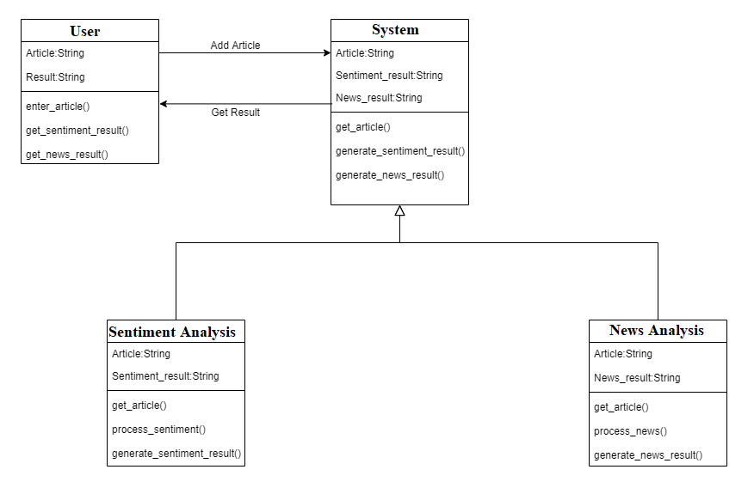
Conceptual Level Class Diagram

Slide 6
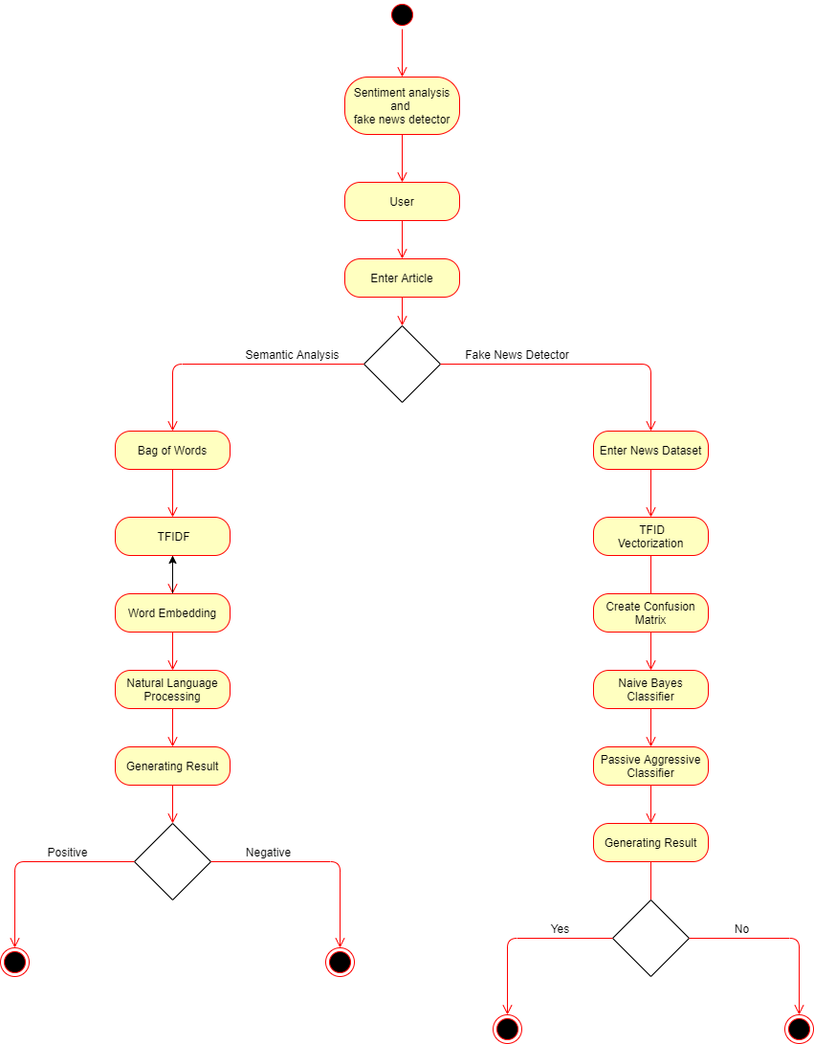
Conceptual Level Activity Diagram

Slide 7
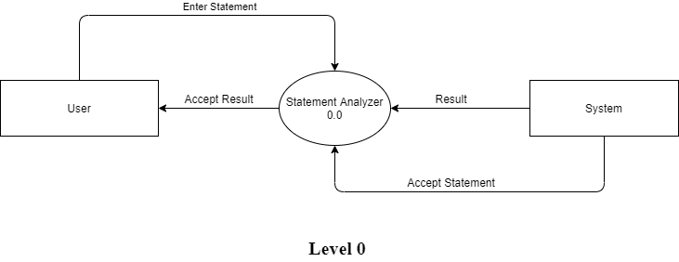
Data Flow Diagram
Figure 5.1

Slide 8
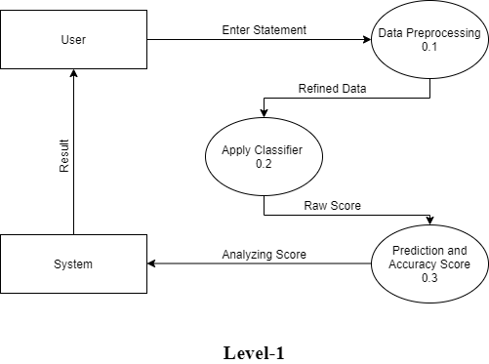
Data Flow Diagram
Figure 5.2

Slide 9
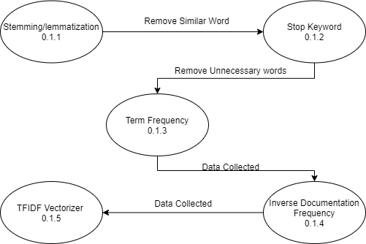
Data Flow Diagram
Figure 5.3

